Slide 1


GPT-6 Astra: The End of the IT Industry or the Beginning of AI-Enabled Aviation?
Generative AI, Agentic AI & the Future of Aviation Management
BBA Aviation Management | Course: Generative AI for Business
Group Members:
Harsh (2520996526)
Gurshan (2520996522)
Parth (2520996548)
Soham (2520996560)
Khushi (2520996535)
Sayam (2520996557)
Somil (2520996561)

Slide 2



The GPT-6 Astra News
SECTION A — NEWS ANALYSIS
Key Capabilities Reported
Article Details
Advanced Reasoning
Headline: "GPT-6 Astra: A New Generation of Intelligence"
Publication: [Insert Publication Name]
Author: [Insert Author]
Date: [Insert Publication Date]
Source: [Insert Website/URL]
Multi-step problem solving and complex logic
Computer Use & Autonomy
Autonomous task execution across systems
Reference: [Full citation with URL — to be completed by group]
Professional Coding
Debugging, development, and code generation
Multimodal Understanding
Text, image, code, and data comprehension
[Screenshot placeholder: Insert News Article Screenshot here]

Slide 3
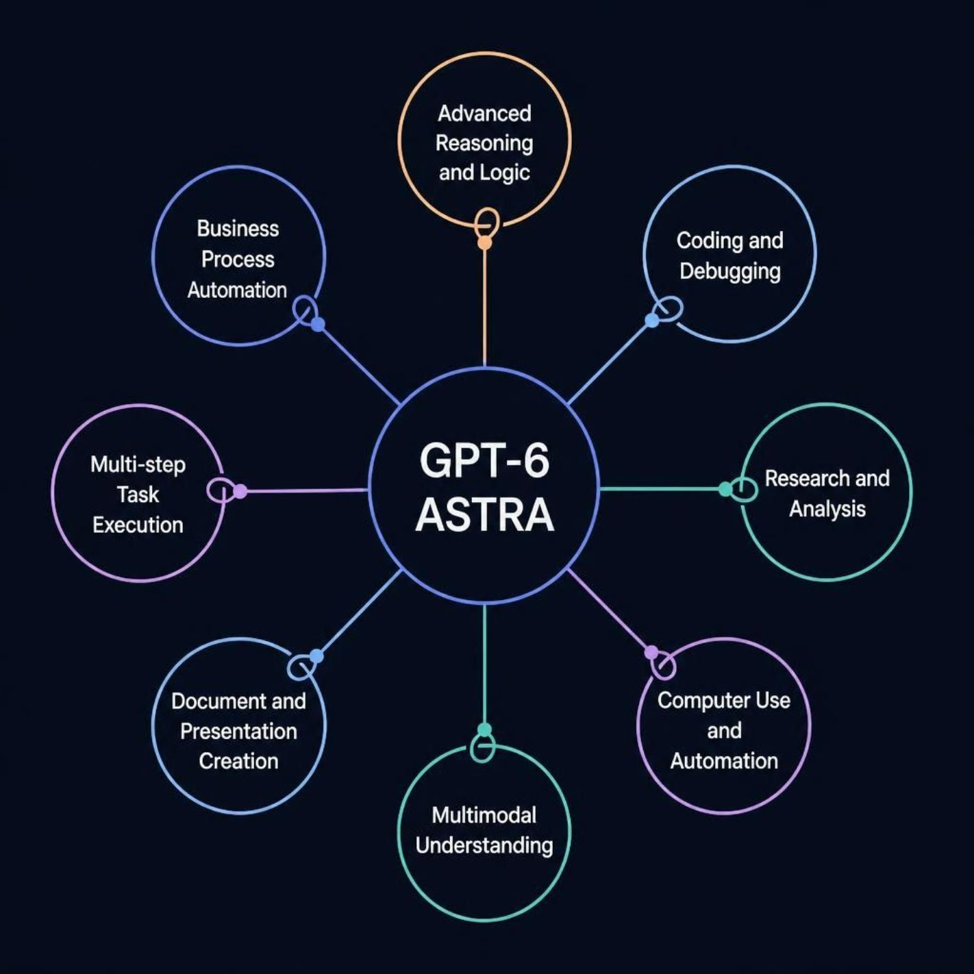
What Can GPT-6 Astra Do?
Traditional AI vs. Agentic AI
Core Capability Areas
Knowledge synthesis & research
Agentic AI workflows
Cybersecurity & threat analysis
Business-process automation
Document & presentation creation
Traditional AI
Agentic AI
Ask → Answer
Single-turn, reactive responses
Goal → Plan → Tools → Execute → Check → Result
Multi-step, autonomous workflows

Slide 4

Impact on the IT Industry
AI represents transformation, not elimination. Roles will evolve — not disappear.
Work Transformation: Traditional → AI-Enabled
Most Affected IT Areas
Traditional Work | AI-Enabled Work
Manual coding | AI-assisted coding
Manual testing | Automated testing
Basic technical support | AI technical support
Manual data analysis | Automated data analysis
Repetitive reporting | AI-generated reports
Software Dev
Tech Support
Data Analysis
Cybersecurity
QA & Testing
BPO & Consulting
Key Insight: Entry-level and repetitive roles face the greatest disruption — but new AI-oversight roles will emerge.

Slide 5





From Generative AI to AI-Enabled Aviation
Passenger Services
Query management, baggage assistance, check-in support
Operations
Crew scheduling, flight-disruption communication, revenue management
Maintenance
Predictive-maintenance documentation, safety-document summarization
Training & Marketing
Training-material development, campaign optimization, knowledge management
AI Capability → Aviation Application → Business Value
Example: Computer Use → Passenger Support System → Faster Service & Reduced Workload

Slide 6

Human + AI: The Aviation Model
Complementary Roles
AI Capabilities | Human Responsibility
Analyse data | Verify accuracy
Search information | Judge relevance
Summarise documents | Approve outputs
Draft communications | Make final decisions
Automate workflows | Take accountability
Critical Human-Controlled Areas
Flight-safety decisions & air-traffic control
Emergency response & aircraft-maintenance approval
Security screening & regulatory compliance
Passenger-data handling & final operational decisions
"AI can support aviation decisions, but responsibility cannot be automated."

Slide 7

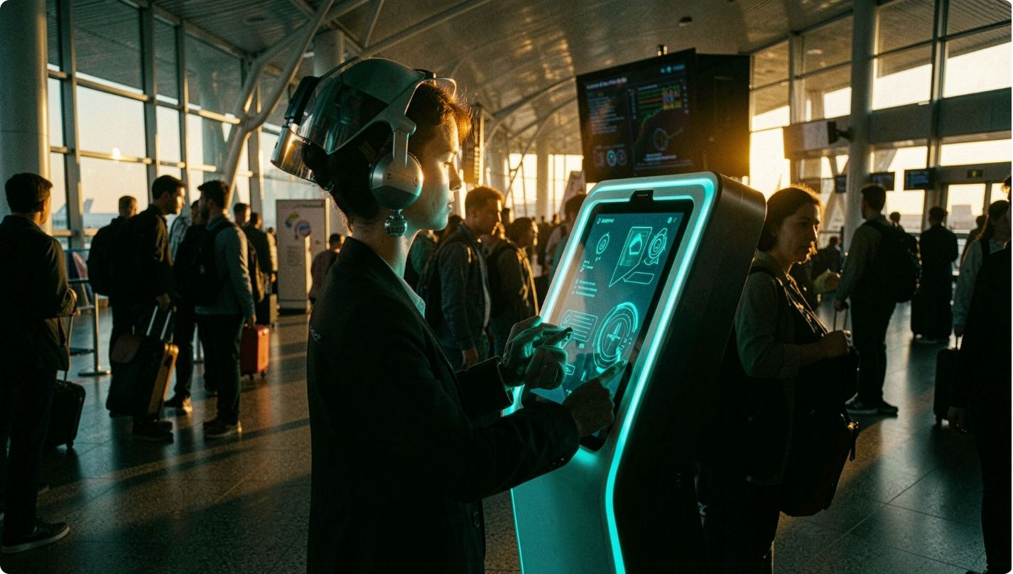


SECTION B — FICTIONAL BUSINESS CASE STUDY
Fictional Aviation Business: SkyLink AI Aviation
FICTIONAL COMPANY — FOR ACADEMIC PURPOSES ONLY
Company Overview
Business Type
AI-powered passenger-assistance and airport-service platform
Target Customers
Airlines, airports, business travellers, tourists, frequent flyers
Business Problem
Airports receive thousands of repetitive passenger questions daily — staff overwhelmed, passengers experience delays
Campaign Objective
Deploy an AI-enabled passenger-support system to improve communication and reduce workload
Tagline: "Smarter Airports. Better Journeys." | Colours: Navy blue · Electric cyan · White | Personality: Professional, intelligent, reliable

Slide 8







GenAI Solution & Multimodal Workflow
Five GenAI Output Prototypes
TEXT
Passenger communication & support responses
SkyLink AI Passenger-Support Workflow
IMAGE
Airport advertisement & promotional materials
VIDEO
Passenger Query
AI Understands
Retrieve Data
AI Generates
Human Review
15–30 second promotional video
Important: All outputs are prototypes and require human verification before operational use.
AUDIO
Passenger announcement & voice guidance
CODE / WEBSITE
Passenger-support interface prototype

Slide 9
Prompts, Outputs & Human Review
Prompt Engineering: Airport Advertisement
Human Review Checklist
[Placeholders: Generated image · Text output · Video thumbnail · Audio QR code · Website screenshot — insert group's actual GenAI outputs here]
Accuracy & Factual Correctness
Verify all AI-generated information against approved sources
Aviation Relevance & Industry Standards
Ensure outputs align with ICAO, IATA, and airline regulations
Tone & Brand Consistency
Match SkyLink AI's professional, passenger-friendly voice
Safety & Compliance
No outputs that could compromise operational safety
Privacy & Data Protection
No real passenger or confidential data used
❌ Weak Prompt
✅ Improved Prompt
"Create an airport advertisement."
"Act as an aviation marketing designer. Create a professional advertisement for SkyLink AI Aviation, an AI-powered passenger-assistance platform for modern airports. Target business travellers and tourists. Use navy blue, cyan and white. Show a realistic modern airport terminal with passengers using an AI assistance kiosk. Communicate reliability, speed and passenger convenience. Use a premium, trustworthy aviation style."

Slide 10
Risks, Verification & Conclusion
Risks of Unverified AI
Human + AI
Responsible AI Framework
Human review & approval required at every stage
Source verification & fact-checking mandatory
Approved aviation information only
Privacy protection & data security enforced
Clear AI disclosure to all users
Safety checks & compliance audits
GPT-6 Astra does not signal the end of IT or aviation jobs. Its capabilities point toward a transformation of digital work — not its elimination.
THE FUTURE IS NOT HUMAN VS AI.
THE FUTURE IS HUMAN + AI.
References
GPT-6 Astra news source & publication [Insert full citation]
OpenAI documentation & research — openai.com
Aviation industry sources & standards (ICAO, IATA)
GenAI tools used by the group [Insert tool names & URLs]
Hallucinations
Data Privacy
Automation Bias
IP Issues
False or fabricated information
Breaches & misuse of passenger data
Over-reliance leading to errors
Intellectual-property & accountability gaps

Slide 11







Harsh (2520996526)
Gurshan (2520996522)
Parth (2520996548)
Sayam (2520996557)
Soham (2520996560)
Khushi (2520996535)
Somil (2520996561)

Slide 12
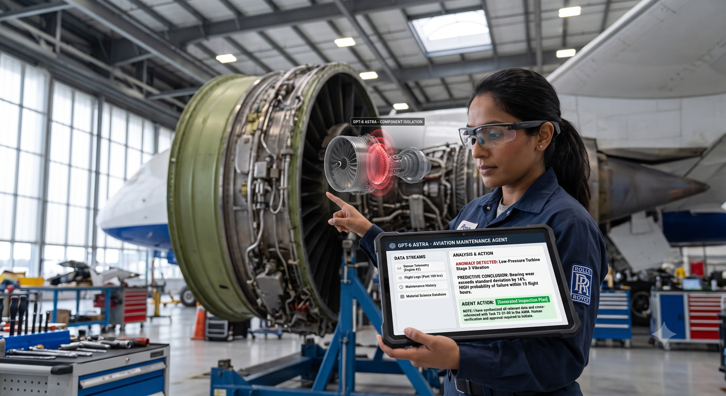

Slide 13
